Slide 1
Extra step maintenance
Maintain word replacement function
Maintain masking profanity function

Slide 2
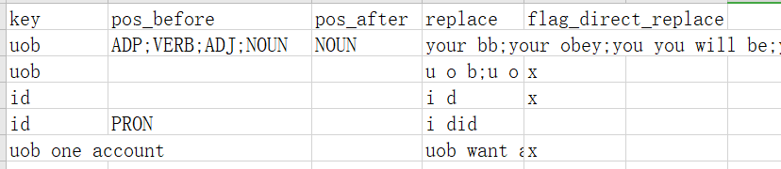
Maintain word replacement function
What is the word replacement function used for?
Problems:
Some Proper Nouns are not learned by machine learning model before. Therefore, pre-trained STT model cannot recognize them correctly.
Expensive and time-consuming to finetune the STT model if new proper nouns occurs.
Methods:
Direct Replacement
POS Tagger
Mark the words to be directly replaced with target words in template.
POS Tagging the words in STT result
Detect if Text from STT result satisfy the pre-defined rules in the rules template file
Detect if Text from STT result contains the words
Template: stt_replace_template.csv
Example

Slide 3
Maintain word replacement function
How does it work?
E.g.
Directly replace: I am David, from u o p.
POS tagger: Check the POS of the preceding or following word. E.g. The POS of the word before ‘uob’ is usually ‘ADP’.
1
‘uob’
Find words to replace.
Words or phrases that sound similar to proper nouns.
2
Use POS tagger: I am David, from your will be.
Note:
POS: Part of Speech

Slide 4
Maintain word replacement function
When does it need to be maintained?
There are new words that need to be replaced, or there are words that no longer need to be replaced, and the template needs to be changed.
How to maintain?
No need to change the code just update the template. (See next page for details.)
Path: uob_website/analysis/utils/stt_replace_template.csv
Template: stt_replace_template.csv
Example

Slide 5
Maintain word replacement function
How to maintain?
Each line represents a rule for a word that needs to be replaced
POS universal_tagset reference: https://universaldependencies.org/u/pos/all.html#al-u-pos/
For column "key": Fill in the word we want, e.g. uob.
For column "pos_before": The POS of a word preceding that word, e.g. ADP.
For column "pos_after": The POS of a word that follows that word, e.g. VERB.
For column "replace": STT may be identified as, e.g. your bb;you will be.
For column "flag_direct_replace": If you want to directly replace some words without considering the part of speech, mark "x" here.
More details can be seen in the examples in following pages.
Note: In the 'pos_before', 'pos_after' and 'replace' columns, if there is more than one possibility, separate each with ';' and do not add spaces before or after the ';'.
e.g. your bb;your obey;you will be
e.g. ADP;VERB
Note: The conditions in pos_before and pos_after are "or", not "and".
Template: stt_replace_template.csv
5 columns

Slide 6
Maintain word replacement function
How to maintain?
Example1 (use pos tagger):
Situation: The word "uob" is often recognized by the STT as "you will be" or "your obey".
1. The correct words for "you will be" and "your obey" are "uob", so they have the same key and can be filled in one line. Fill "you will be" and "your obey" into the column 'replace' separated by a semicolon ";", and fill in "uob" into the column 'key'.
2. Consider often adding prepositions and verbs before the correct vocabulary "uob", such as "calling from uob", choose uob", and often adding nouns after "uob", such as "uob account", however those for "you will be", "your obey" not often occur together. So refer to POS universal_tagset reference: https://universaldependencies.org/u/pos/all.html#al-u-pos/, fill "ADP;VERB" into column 'pos_before', and fill in "NOUN" into column 'pos_after'.
Because the method of using POS tagger is selected instead of direct replacement, the fifth column 'flag_direct_replace' can be left blank.
A rule is done just like that.
Template: stt_replace_template.csv
5 columns

Slide 7
Maintain word replacement function
How to maintain?
Example2 (directly replace):
Situation: "n r i c" often appears in STT results as individual letters instead of "nric".
Want to replace "n r i c" directly with "nric" in STT results.
Fill "nric" into column 'key', fill "n r i c" into column 'replace', do not need to fill in columns 'pos_before' and 'pos_after', fill in "x" in column 'flag_direct_replace'.
A direct replacement rule is done.
Template: stt_replace_template.csv
5 columns

Slide 8
Maintain word replacement function
How to maintain?
Very important:
In the 'replace' column, if there is an inclusion relationship, such as "n r i c" including "i c", the included ones should be written at the back. Such as "n r i c;ic".
If there are two 'key', that is, "n r i c" is replaced by "nric", "ic" is replaced by "ic". In this case, two lines of rules need to be written, and the included one should be written below, as shown below.
The rule of "i c" is written below "n r i c".

Slide 9
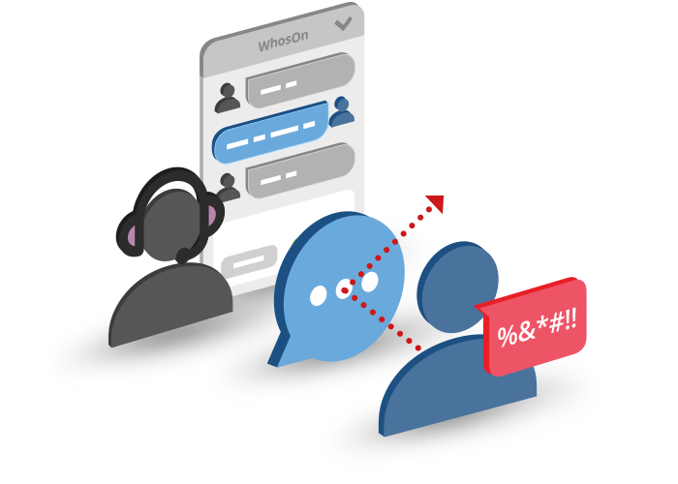
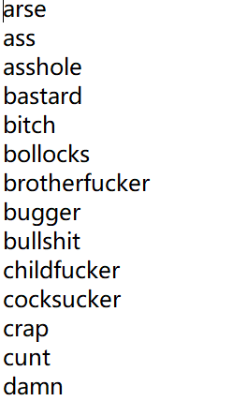
Maintain masking profanity function
What is the masking profanity function used for? And how does it work?
Used to mask bad words.
Replace words in swear_words_list.txt with '***'.
swear_words_list.txt
Input: Text
Mask with ‘***’
Swear words list
Output: Text
Example

Slide 10
Maintain masking profanity function
How to maintain?
Just add or delete words in the swear_words_list.txt.
Path: uob_website/analysis/utils/swear_words_list.txt
swear_words_list.txt
Example

Slide 11
Labeling maintenance
Maintain labeling template
Retrain the Word2Vec model on colab

Slide 12


Labeling
What is the labeling used for? And how does it work?
Speaker Label | Text
Speaker 0 | Hello
Speaker 1 | Hello good afternoon
Word2Vec Model
(Word Mover's Distance)
SD: Speaker N
Agent
STT: Audio Text
Checklist
(Template)
Customer
Hello, this is … calling from UOB
NRIC/Passport number
Your education qualification
Length of investment required from you
……

Slide 13
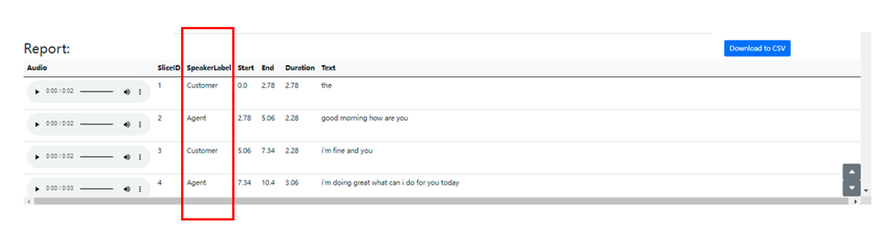
Labeling
What is the labeling used for?
Labeling is to identify which of Speaker 0 and Speaker 1 distinguished by SD module is the Agent and which is the Customer. Distinguishing Agent and Customer is helpful for subsequent analysis of a series of use cases.

Slide 14
Labeling
How does it work?
After we have the discrimination results of Speaker 0 and Speaker 1 of SD and the text results of STT, we use the Agent speech template (In current case called 'checklist') given by the company to calculate the similarity between the speech template and the text of speakers respectively. The more similar speaker is labeled as Agent, and the other is labeled as Customer.
In a more theoretical process, we will convert the text from Speaker 0 and Speaker 1 and the speech template into vectors through the pre-trained Word2Vec model and calculate the similarity through Word Mover's Distance. The smaller the distance, the more similar the text is. If the text is more similar to the Agent speech template, label the speaker as Agent.

Slide 15
Maintain
When does it need to be maintained?
At present, the common phrases used by Agent in the application scenarios of Mystery Shopping and Call Center have been added to checklist.txt.
If you change to a new business scenario, it is best to modify checklist.txt and retrain the Word2Vec model in colab (very convenient and fast(a few seconds)).
If maintenance is required, first maintain the checklist.txt, and then use the new checklist.txt to retrain the Word2Vec model.

Slide 16
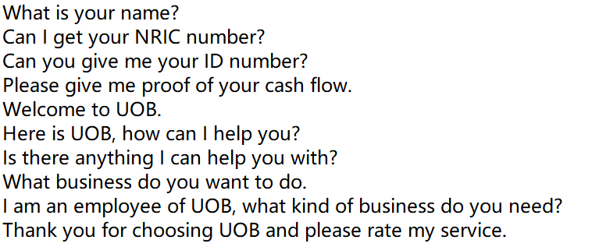
Maintain labeling template
Path: pretrained-model/label/checklist.txt
checklist.txt example:

Slide 17
Maintain labeling template
checklist.txt example:
How to maintain?
You can directly add the commonly used text of Agent（not Customer) in this txt, the more data the better. Then put the checklist.txt under the path: main/pretrained/model/label/checklist.txt
Next, train a new Word2Vec model with this new checklist.txt!

Slide 18
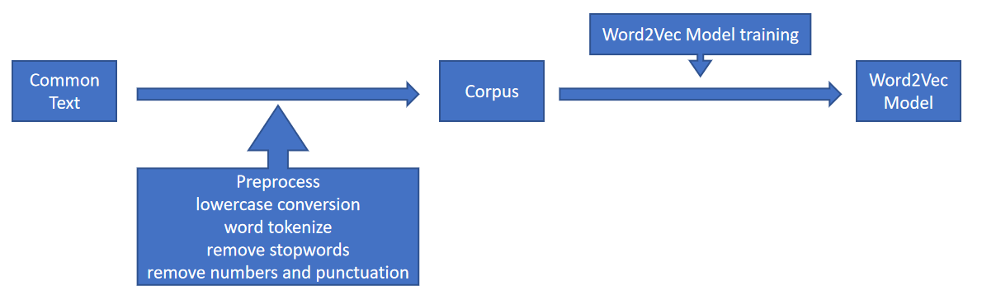
Retrain the Word2Vec model on colab
Code path: in the ucloud folder: Documentation/Labeling model maintain(retrain)
Labelling_w2vtrainmodel.ipynb (train on colab) (recommend)
labelling_w2vtrainmodel.py (train on prem)
Workflow:

Slide 19
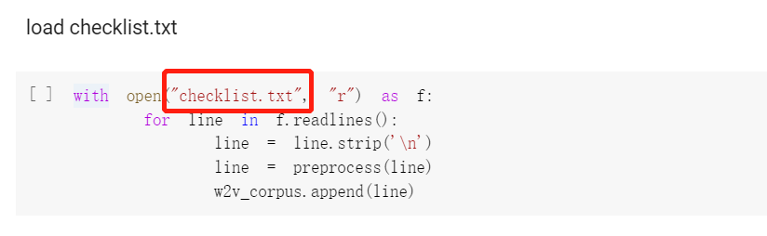
Retrain the Word2Vec model on colab
Need to prepare:
checklist.txt with common text of Agent
How to use code:
1. Put the path of checklist.txt here.

Slide 20
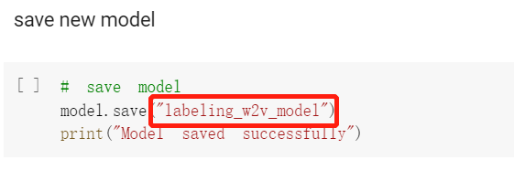
Retrain the Word2Vec model on colab
How to use code:
2. Put the path and name of the new model here.
As shown in the figure below, if only the name is entered, the model will be stored in the default path.
3. The rest of the code can be run directly without changes, and training on colab is fast.
4. Next, put the new model into the path: pretrained-model/label. Replace the existing label_wordvector_model.

Slide 21
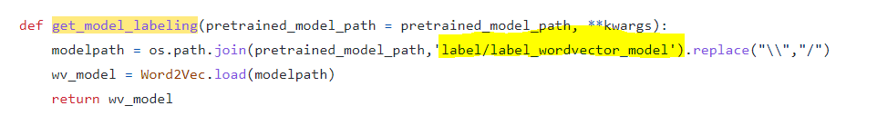
Retrain the Word2Vec model on colab
How to use code:
5. The model name needs to be changed in the python code file, uob_website/analysis/uob_extractmodel.py.
If you save the new model name as the same “label_wordvector_model”, you can directly replace the model and omit this step.

Slide 22
How to test STT accuracy
By character
By words

Slide 23
Difference
For example:
By character the accuracy for the example is 83.33%. Differences of only one space will be considered.
By words the accuracy for the example is 0%. Because there are no words to match.
Accurate transcript | STT results
justin | just in

Slide 24
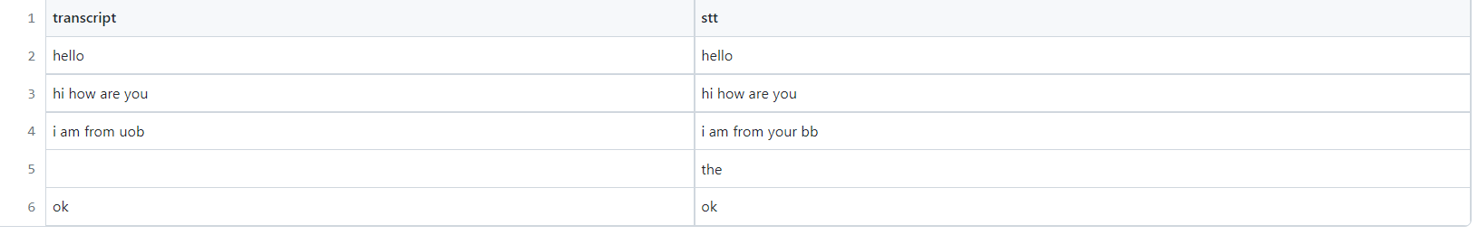
How to test STT accuracy
Code path: in the ucloud folder: Documentation/Test documentation/Test3 STT Accuracy
accuracy by character.py
accuracy by words.py
How to use:
1. First prepare a csv or excel with two columns. One column 'transcript' is the actual text, and one column 'stt' is the result of stt. As shown below:

Slide 25



How to test STT accuracy
How to use:
2. Write path
For excel:
For csv:
3. Path to output file
4. Run the code

